Slide 1
voizFonica
Presented By
Suriya Stephen

Slide 2
INTRODUCTION
Mobile Network Operator and telephone company.
Network access and telecommunication services.
Easy, efficient and environmentally friendly way.
Secure

Slide 3
voizFonica deals with
Prepaid -70% of customers
Postpaid-20% of customers
Dongle-10% of customers
Objective:
To increase profitability of the company by satisfying the customer needs.

Slide 4
Technology
Front-End – Angular,Bootstrap,HTML,CSS
Back-End - SpringBoot ,MYSQL
Software tools : Visual Studio Code, Spring Tool Suite

Slide 5
Angular – SpringBoot Integration
#1
/all
FRONT-END
BACK-END
#2
Component
Service
SpringBoot
TS
#3
s
DB
#4
HttpClient
GET/POST/DELETE/PUT
(CRUD)
#11
ngOnInit()
#5
#6
HTML
LIST<T>
Request
#10
#7
#9
Response
subscribe
JSON
#8
Observable<T>

Slide 6
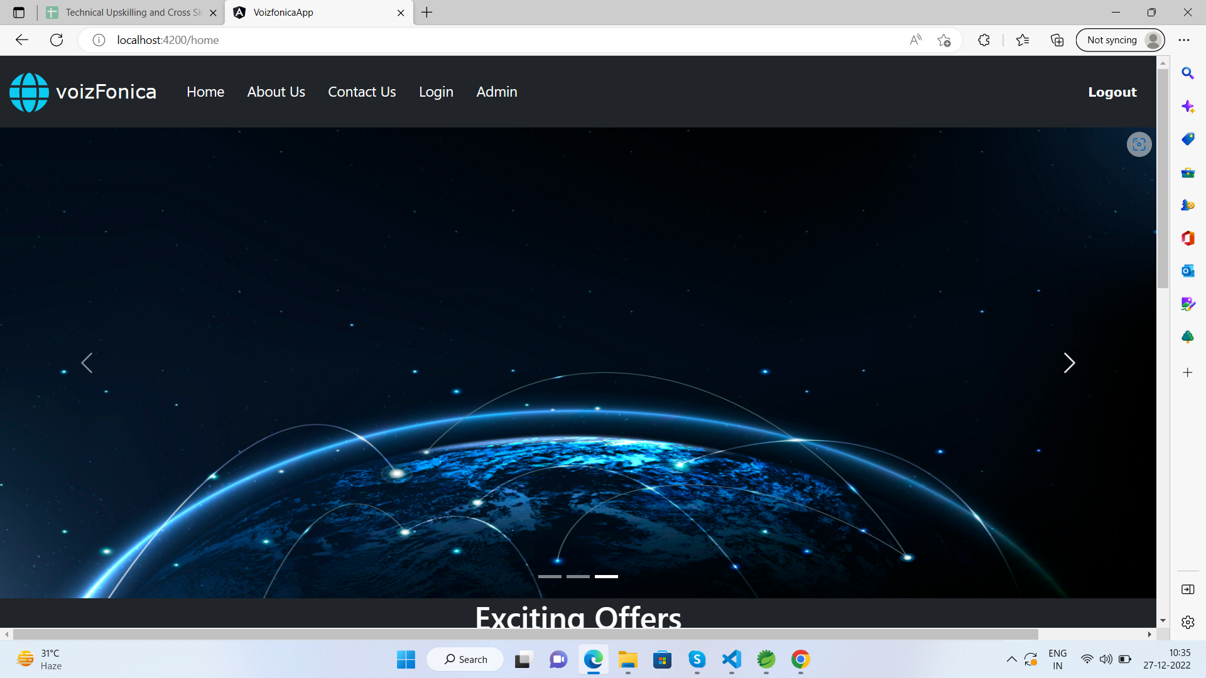
SCREENSHOTS

Slide 7
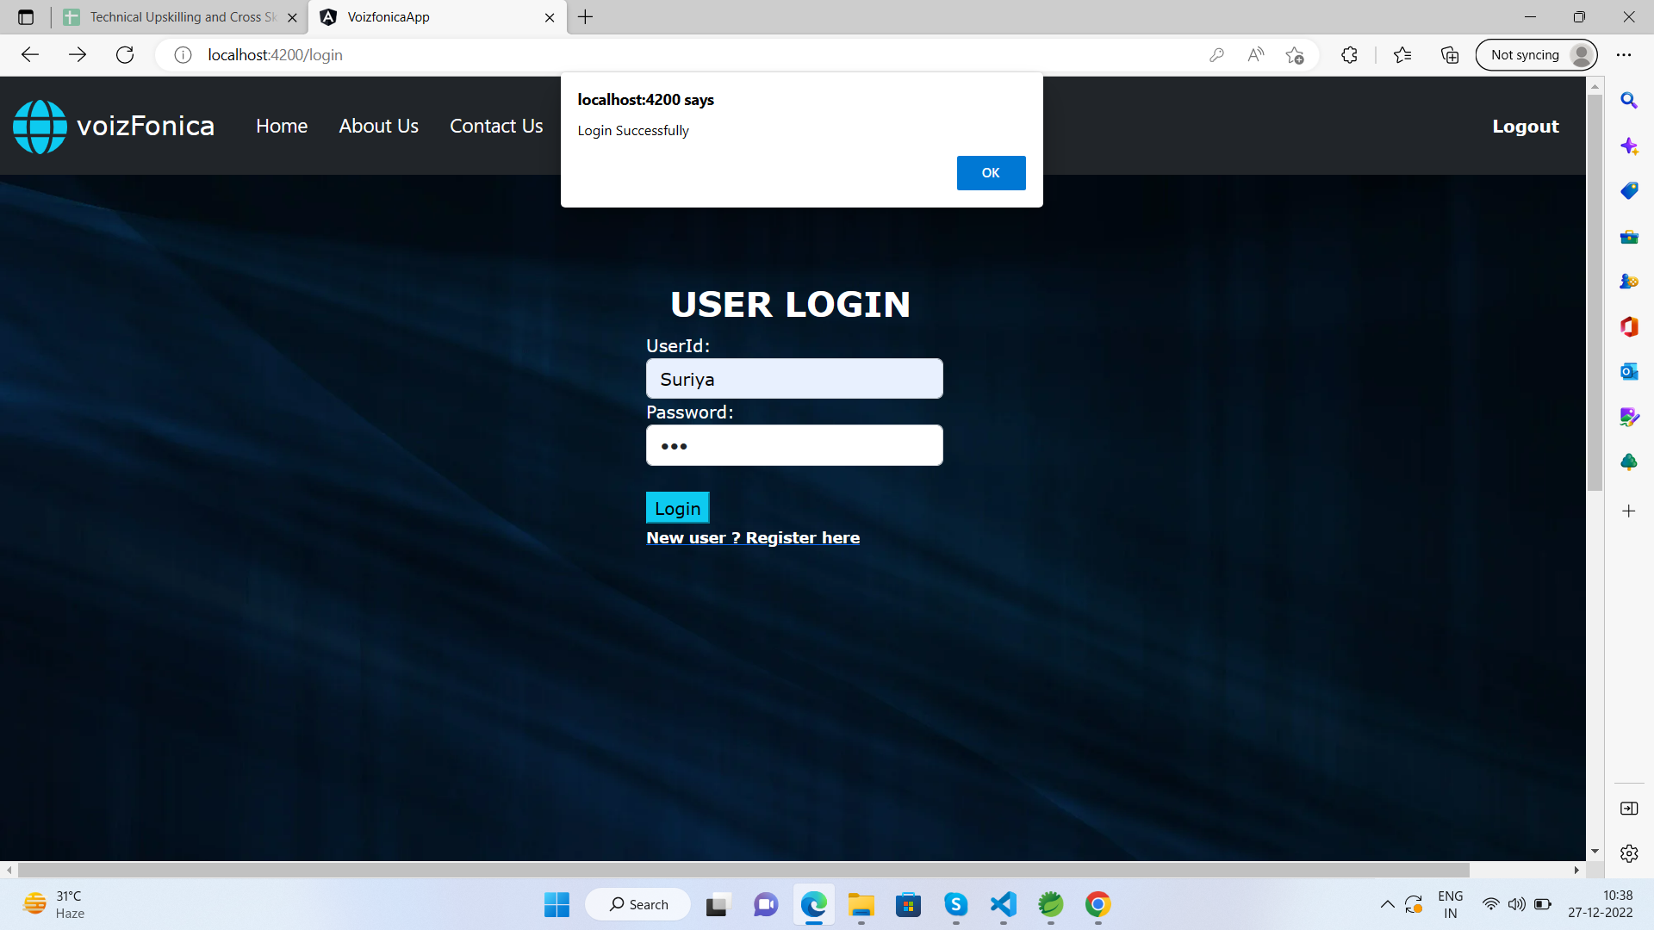

Slide 8
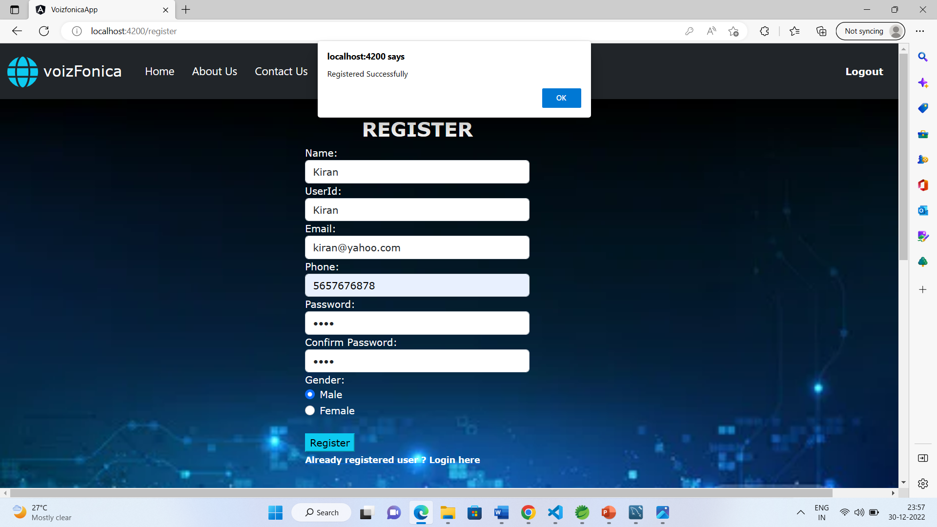

Slide 9
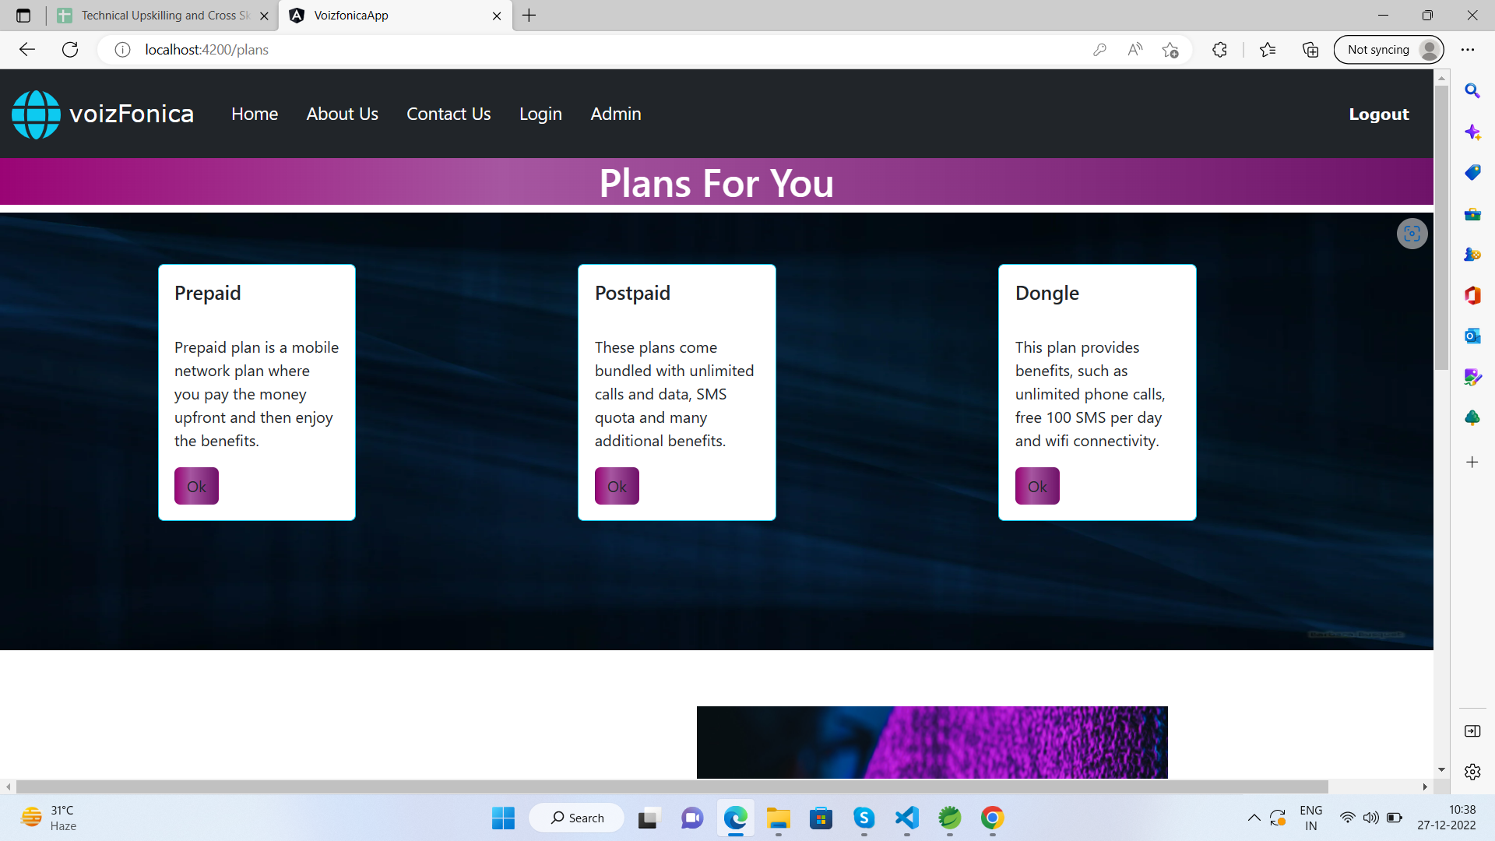

Slide 10
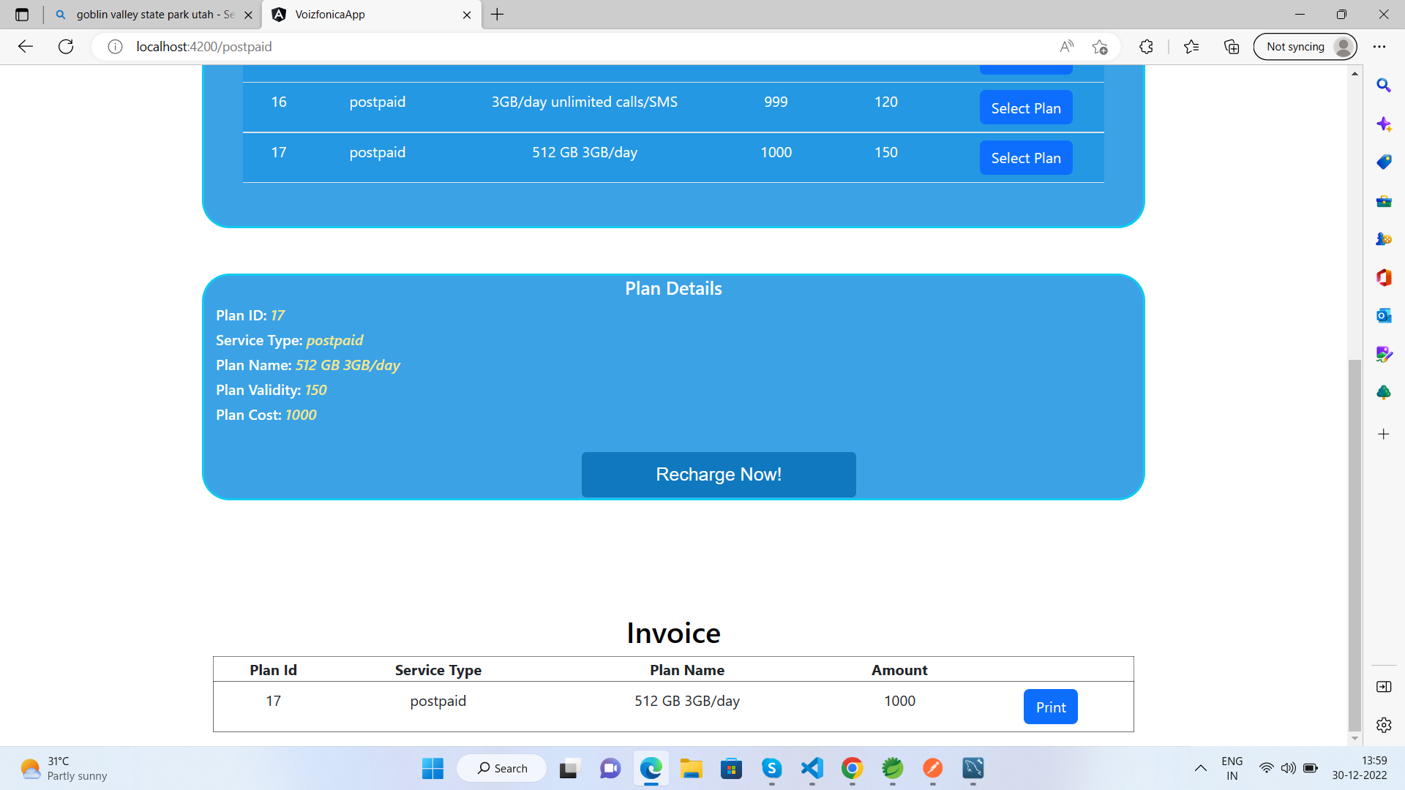

Slide 11
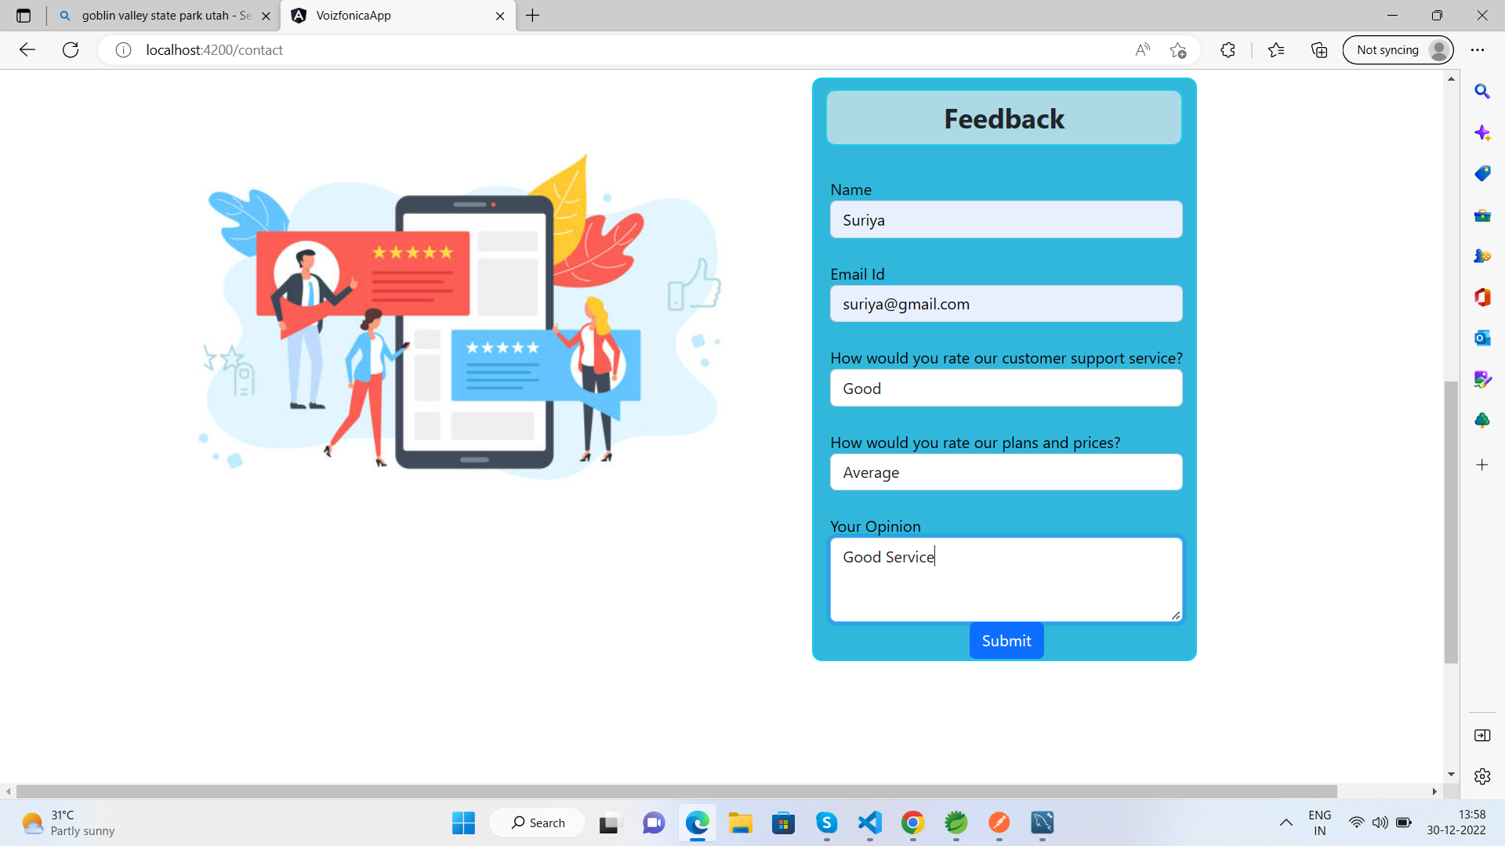

Slide 12
THANK YOU

